Slide 1
Data Structures Chapter 1
Recursion
Performance Analysis
Asymptotic Analysis
Revisit – Step Count
Asymptotic Analysis
Asymptotic Notations

Slide 2
Revisit – Step Count
Why step count?
It is to compare the time complexities of two programs that compute the same function and also to predict the growth rate in run time.
Example: Let’s compute the step count for three programs and compare their time complexities.
T_{add}(n) – adding two numbers
T_{sum}(n) – adding list of numbers
T_{mtx}(n) – adding two matrix

Slide 3
Revisit – Step Count n
Program add | step count
float add(int a, int b) { return a + b; } | 1
Program sum of list | step count
float sum(float list[], int n) { float total = 0; int i; for (i=0; i<n; i++) total += list[i]; return total; } | 1 n + 1 n 1
Program sum of matrix | step count
void add(int a[][MAX_SIZE], int b[][MAX_SIZE], int c[][MAX_SIZE}, int rows, int cols) { for(int i=0; i<rows; i++) for(iny j=0; j<cols; j++) c[i][j] = a[i][j] + b[i][j]; } | rows + 1 rows * (cols+1) rows * cols

Slide 4

Revisit – Step Count n
$Tadd(n) = 2$
$Tsum\left(n\right)= 1+ 2\left(n+1\right)+ 2n + 1 = 4n + 4$
$= c∗n + c’$
$Tmtx\left(n\right)= 2 rows∗cols + 2 rows + 1$
$= a∗ n2 + b∗n + c$

Slide 5
Revisit – Step Count n
→ O(1)
$Tadd(n) = 2$
$Tsum\left(n\right)= 1+ 2\left(n+1\right)+ 2n + 1 = 4n + 4$
$= c∗n + c’$
$Tmtx\left(n\right)= 2 rows∗cols + 2 rows + 1$
$= a∗ n2 + b∗n + c$
→ O(n)
→ O(n²)

Slide 6
Revisit – Step Count n
→ O(1)
$Tadd(n) = 2$
$Tsum\left(n\right)= 1+ 2\left(n+1\right)+ 2n + 1 = 4n + 4$
$= c∗n + c’$
$Tmtx\left(n\right)= 2 rows∗cols + 2 rows + 1$
$= a∗ n2 + b∗n + c$
→ O(n)
→ O(n²)
T_{mtx}(n)
T_{sum}(n)
time
T_{add}(n)
input n

Slide 7

Asymptotic Analysis 점근적 분석과 표기법
The "Big-Oh" Notation:
Let f(n) and g(n) be functions mapping nonnegative integers to real numbers. We say that f(n) is O(g(n)) iff there are positive constants c and n₀ such that
$f(n) ≤ c g(n), for n ≥ n0.$
Then it is pronounced as $"f\left(n\right) is big Oh of g(n) or f(n) = O(g(n))"$

Slide 8
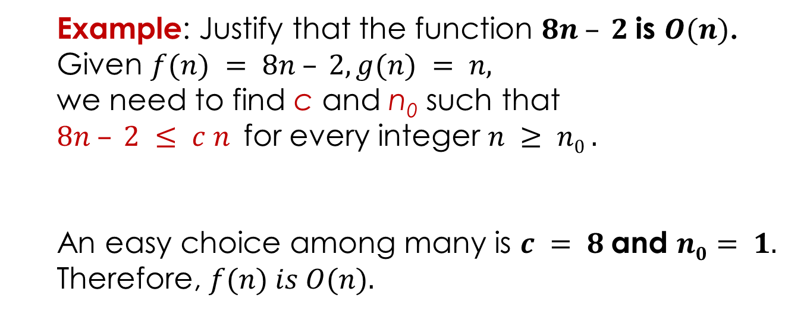


Asymptotic Analysis 점근적 분석과 표기법
The "Big-Oh" Notation:
Let f(n) and g(n) be functions mapping nonnegative integers to real numbers. We say that f(n) is O(g(n)) iff there are positive constants c and n₀ such that
$f(n) ≤ c g(n), for n ≥ n0.$
Then it is pronounced as $"f\left(n\right) is big Oh of g(n) or f(n) = O(g(n))"$
c g(n)
Example: Justify that the function $8n – 2$is $O(n)$.
Given $f(n) = 8n – 2, g(n) = n,$
we need to find c and n₀ such that
$8n – 2 ≤ c n$for every integer $n ≥ n0 .$
An easy choice among many is $c = 8$and $n0= 1.$
Therefore, $f(n) is O(n).$
running
time
$$upper$$
$$bound$$
f(n)
n₀
input size n
$$g(n)=n$$

Slide 9

Asymptotic Analysis 점근적 분석과 표기법
Example: Find c and $n0$ to justify that the function $7n + 5$is $O(n)$.
7n + 5 is O(n), we have to find c and $n0$ such that
7n + 5 ≤ c n $for n ≥ n0$
c g(n)
running
time
$$upper$$
$$bound$$
f(n)
n₀
input size n

Slide 10
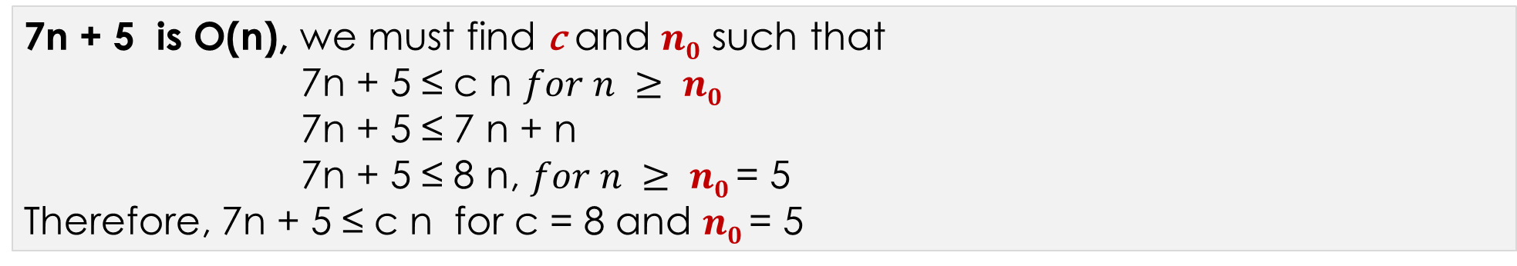
Asymptotic Analysis 점근적 분석과 표기법
Example: Find c and $n0$ to justify that the function $7n + 5$is $O(n)$.
7n + 5 is O(n), we must find c and $n0$ such that
7n + 5 ≤ c n $for n ≥ n0$
7n + 5 ≤ 7 n + n
7n + 5 ≤ 8 n, $for n ≥ n0$= 5
Therefore, 7n + 5 ≤ c n for c = 8 and $n0$= 5
c g(n)
running
time
$$upper$$
$$bound$$
f(n)
n₀
input size n

Slide 11
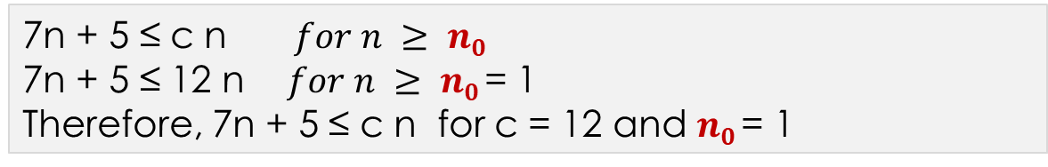
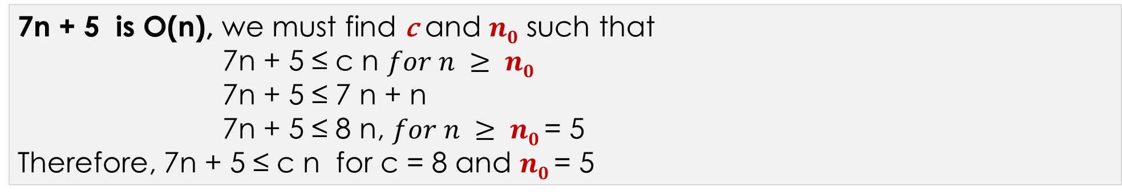
Asymptotic Analysis 점근적 분석과 표기법
Example: Find c and $n0$ to justify that the function $7n + 5$is $O(n)$.
7n + 5 is O(n), we must find c and $n0$ such that
7n + 5 ≤ c n $for n ≥ n0$
7n + 5 ≤ 7 n + n
7n + 5 ≤ 8 n, $for n ≥ n0$= 5
Therefore, 7n + 5 ≤ c n for c = 8 and $n0$= 5
c g(n)
running
time
$$upper$$
$$bound$$
7n + 5 ≤ c n $for n ≥ n0$
7n + 5 ≤ 12 n $for n ≥ n0$= 1
Therefore, 7n + 5 ≤ c n for c = 12 and $n0$= 1
f(n)
n₀
input size n

Slide 12

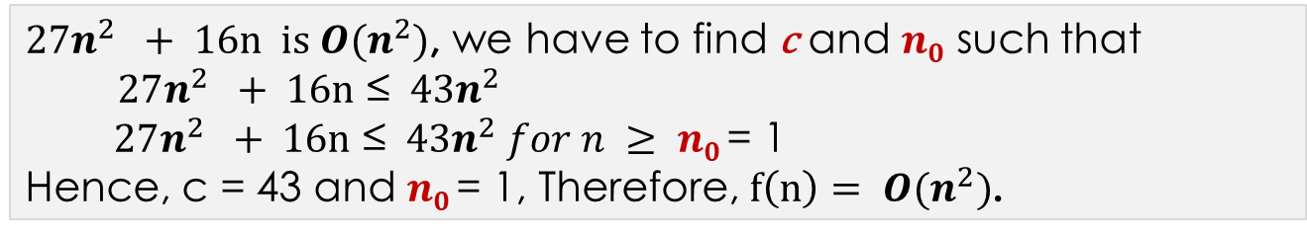
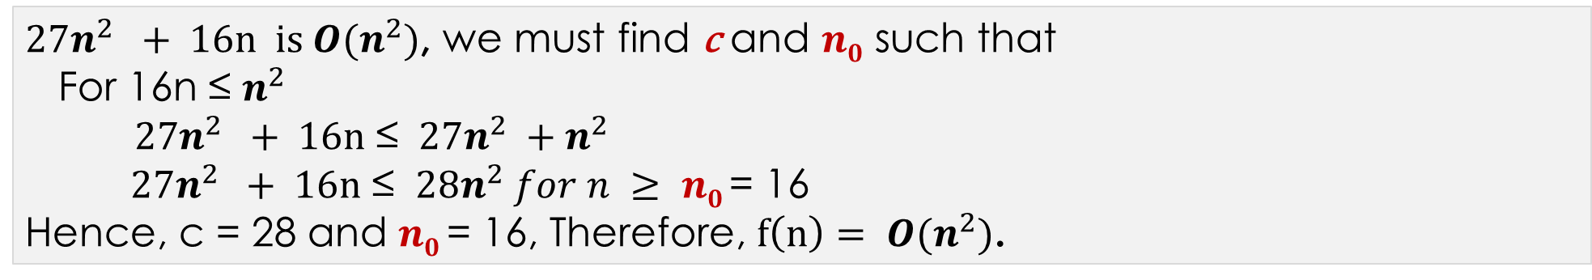
Asymptotic Analysis 점근적 분석과 표기법
Example: Find c and $n0$ to justify that the function $27n^{2}+ 16n$is $O(n^{2})$.
$27n^{2} + 16n is O(n^{2})$, we must find c and $n0$ such that
For 16n ≤ $n^{2}$
$27n^{2} + 16n$ ≤ $27n^{2} +n^{2}$
$27n^{2} + 16n$ ≤ $28n^{2} for n ≥ n0$= 16
Hence, c = 28 and $n0$= 16, Therefore, $f\left(n\right)= O(n^{2})$.
c g(n)
running
time
$$upper$$
$$bound$$
$27n^{2} + 16n is O(n^{2})$, we have to find c and $n0$ such that
$27n^{2} + 16n$ ≤ $43n^{2}$
$27n^{2} + 16n$ ≤ $43n^{2} for n ≥ n0$= 1
Hence, c = 43 and $n0$= 1, Therefore, $f\left(n\right)= O(n^{2})$.
f(n)
n₀
input size n

Slide 13

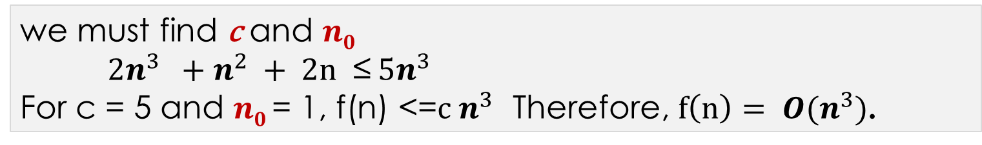
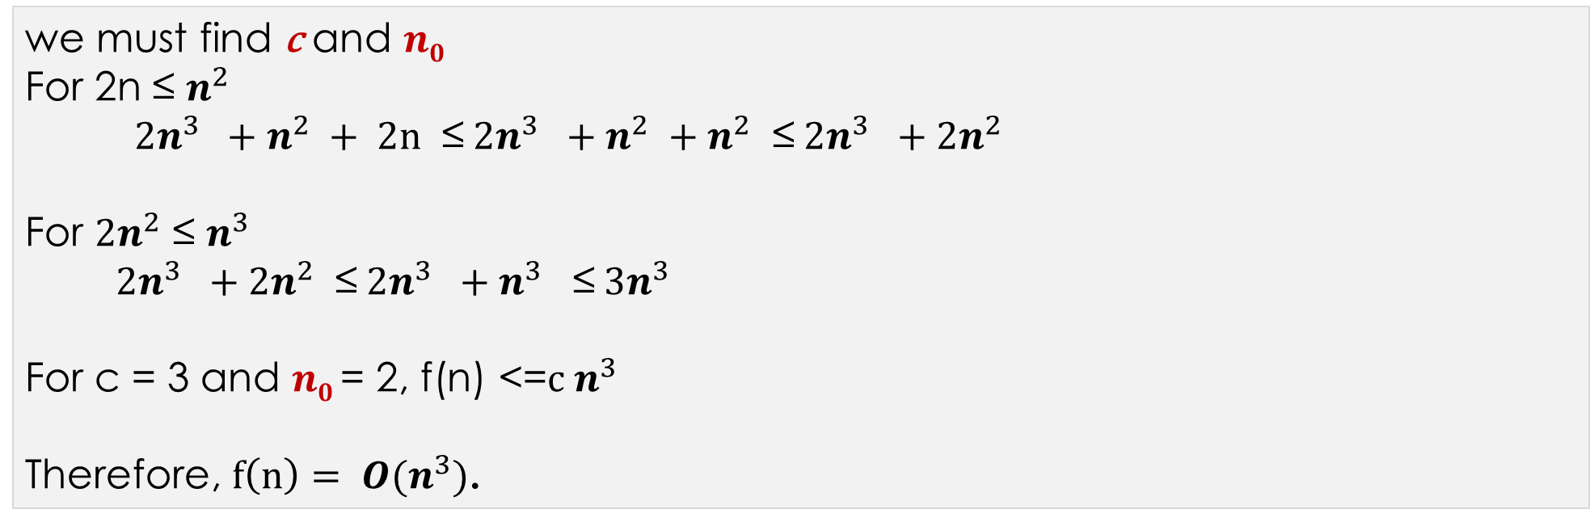
Asymptotic Analysis 점근적 분석과 표기법
Example: Find c and $n0$ to justify $2n^{3}+n^{2}+2n$is $O(n^{3})$.
we must find c and $n0$
For 2n ≤ $n^{2}$
$2n^{3} +n^{2} + 2n$ ≤$2n^{3} +n^{2} +n^{2}$ ≤$2n^{3} +{2n}^{2}$
For ${2n}^{2}$ ≤ $n^{3}$
$2n^{3} +{2n}^{2}$ ≤$2n^{3} +n^{3}$ ≤$3n^{3}$
For c = 3 and $n0$= 2, f(n) <=$c n^{3}$
Therefore, $f\left(n\right)= O(n^{3})$.
we must find c and $n0$
$2n^{3} +n^{2} + 2n$ ≤$5n^{3}$
For c = 5 and $n0$= 1, f(n) <=$c n^{3}$ Therefore, $f\left(n\right)= O(n^{3})$.

Slide 14

Asymptotic Analysis 점근적 분석과 표기법
More Examples:
$3n+2 =O(n) since 3n+2≤4n for n≥2$
$3n+3 =O(n) since 3n+3≤4n for n ≥3$
$100n+6=O(n) since 100n + 6 ≤101n for n≥6$
$10n2+4n+2 = O(n2) since 10n2+4n+2 ≤11n2 for n≥5,$
$6∗2n+n2 = O(2^{n}) since 6∗2n+n2 ≤ 7∗2n for n≥4$
$3n+3 =O(n2) since 3n+3≤3n2 for n≥2$
$10n2+4n+2 =O(n4) since 10n2+4n+2 ≤10n4 for n≥2,$
$3n+2≠O(1) as 3n + 2 is not≤c for any c and all n, n ≥ n0.$
$10n2+4n+2 ≠O(n)$

Slide 15
Asymptotic Analysis 점근적 분석과 표기법
Preferred Big-Oh usage:
Pick the tightest bound. If f(N) = 5N, then:
f(N) = O(N⁵)
f(N) = O(N³)
f(N) = O(N log N)
f(N) = O(N) ← preferred or right!

Slide 16
Asymptotic Analysis 점근적 분석과 표기법
Preferred Big-Oh usage:
Pick the tightest bound. If f(N) = 5N, then:
f(N) = O(N⁵)
f(N) = O(N³)
f(N) = O(N log N)
f(N) = O(N) ← preferred or right!
Ignore constant factors and low order terms:
f(N) = O(N), not f(N) = O(5N)
f(N) = O(N³), not f(N) = O(N³ + N² + 15)
Wrong: f(N) ≤ O(g(N))
Wrong: f(N) ≥ O(g(N))
Right: f(N) = O(g(N))

Slide 17


Asymptotic Analysis 점근적 분석과 표기법
Suppose two algorithms, A and B, solving the same problem have the running time of $O(n)$ and $O(n2)$, respectively.
Then algorithm A is asymptotically better than algorithm B.
※ $O(1) < O(log⁡n) < O(n) < O(n log⁡n) < O(n2) < O(n3) < O(2n)$
logarithmic
linear
linearithmic
quadratic
cubic
exponential
정수함수
대수
선형함수
선형대수
loglinear
2/3승함수
지수함수
$$T\left(n\right)=a nb$$

Slide 18
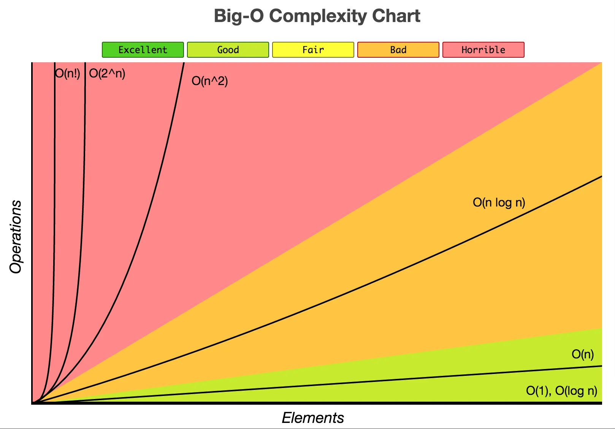
Asymptotic Analysis 점근적 분석과 표기법
$$O(1) < O(log⁡n) < O(n) < O(n log⁡n) < O(n2) < O(n3) < O(2n)$$
$$T\left(n\right)=a nb$$

Slide 19

Asymptotic Analysis 점근적 분석과 표기법
[Omega] f(n) = Ω (g(n)) iff there exist positive constants c and n₀ such that
$$f(n) ≥ c g(n), for n ≥ n0.$$

Slide 20
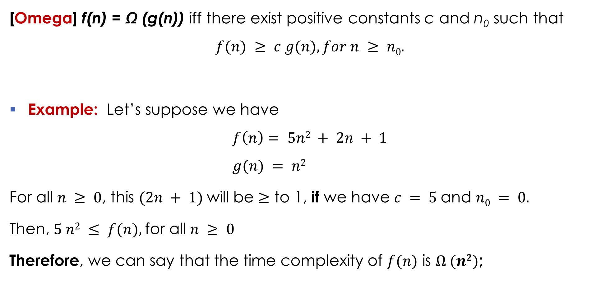
Asymptotic Analysis 점근적 분석과 표기법
[Omega] f(n) = Ω (g(n)) iff there exist positive constants c and n₀ such that
$$f(n) ≥ c g(n), for n ≥ n0.$$
Example: Let’s suppose we have $f\left(n\right)= 5n2 + 2n + 1$ $g(n) = n2$
For all $n ≥ 0$, this $(2n + 1)$will be $≥$ to 1, if we have $c = 5$and $n0 = 0.$
Then, $5 n2 ≤ f(n),$for all $n ≥ 0$
Therefore, we can say that the time complexity of $f(n)$ is $Ω (n2)$;

Slide 21
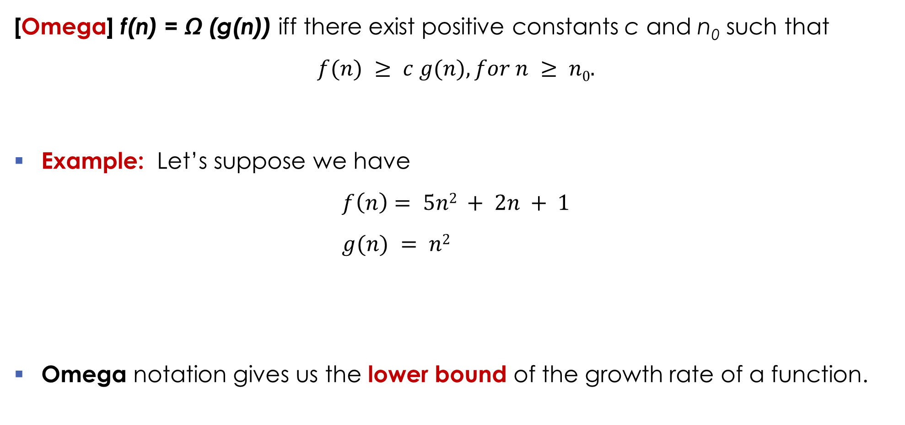
Asymptotic Analysis 점근적 분석과 표기법
[Omega] f(n) = Ω (g(n)) iff there exist positive constants c and n₀ such that
$$f(n) ≥ c g(n), for n ≥ n0.$$
Example: Let’s suppose we have $f\left(n\right)= 5n2 + 2n + 1$ $g(n) = n2$
Omega notation gives us the lower bound of the growth rate of a function.
time
f(n)
c g(n)
n₀ = 0
input n

Slide 22
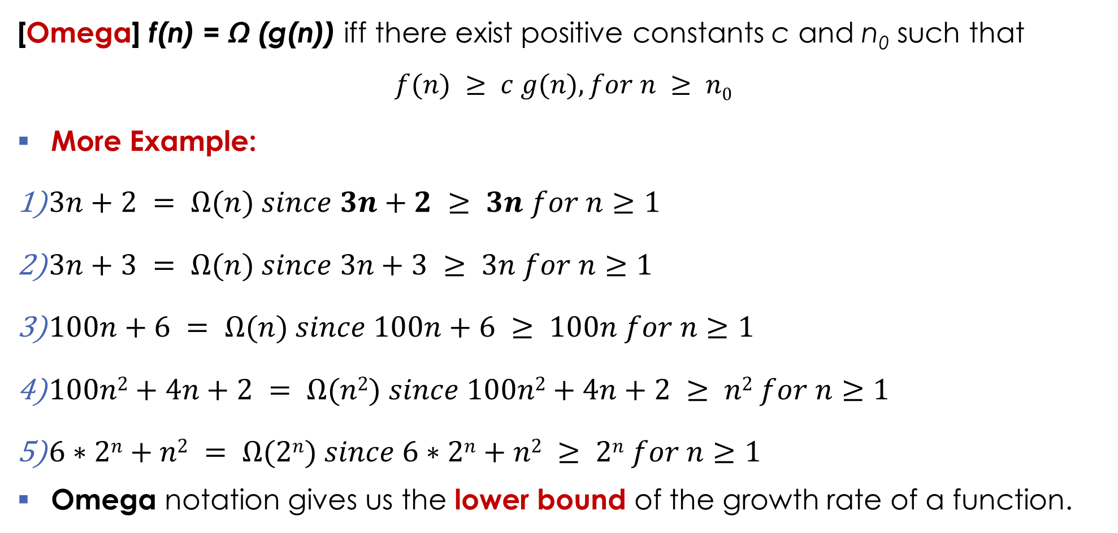
Asymptotic Analysis 점근적 분석과 표기법
[Omega] f(n) = Ω (g(n)) iff there exist positive constants c and n₀ such that
$$f(n) ≥ c g(n), for n ≥ n0$$
More Example:
$3n+2 = Ω(n) since 3n+2 ≥ 3n for n≥1$
$3n+3 = Ω(n) since 3n+3 ≥ 3n for n≥1$
$100n+6 = Ω(n) since 100n+6 ≥ 100n for n≥1$
$100n2+4n+2 = Ω(n2) since 100n2+4n+2 ≥ n2 for n≥1$
$6∗2n+n2 = Ω(2n) since 6∗2n+n2 ≥ 2n for n≥1$
Omega notation gives us the lower bound of the growth rate of a function.

Slide 23
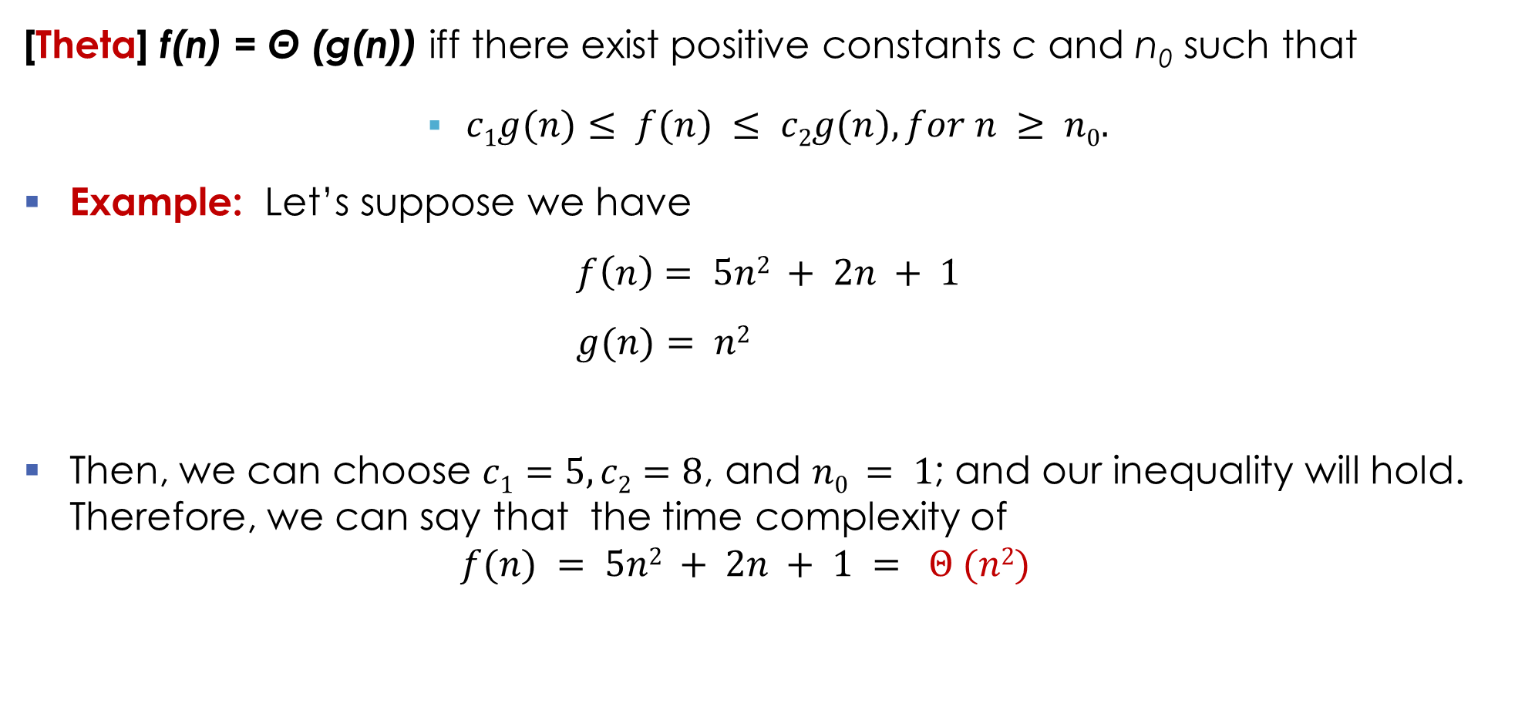
Asymptotic Analysis 점근적 분석과 표기법
[Theta] f(n) = Θ (g(n)) iff there exist positive constants c and n₀ such that
$c1g(n)≤ f(n) ≤ c2g(n), for n ≥ n0.$
Example: Let’s suppose we have $f\left(n\right)= 5n2 + 2n + 1$ $g(n)= n2$
Then, we can choose $c1=5, c2=8$, and $n0 = 1$; and our inequality will hold. Therefore, we can say that the time complexity of $f(n) = 5n2 + 2n + 1 = Θ (n2)$

Slide 24
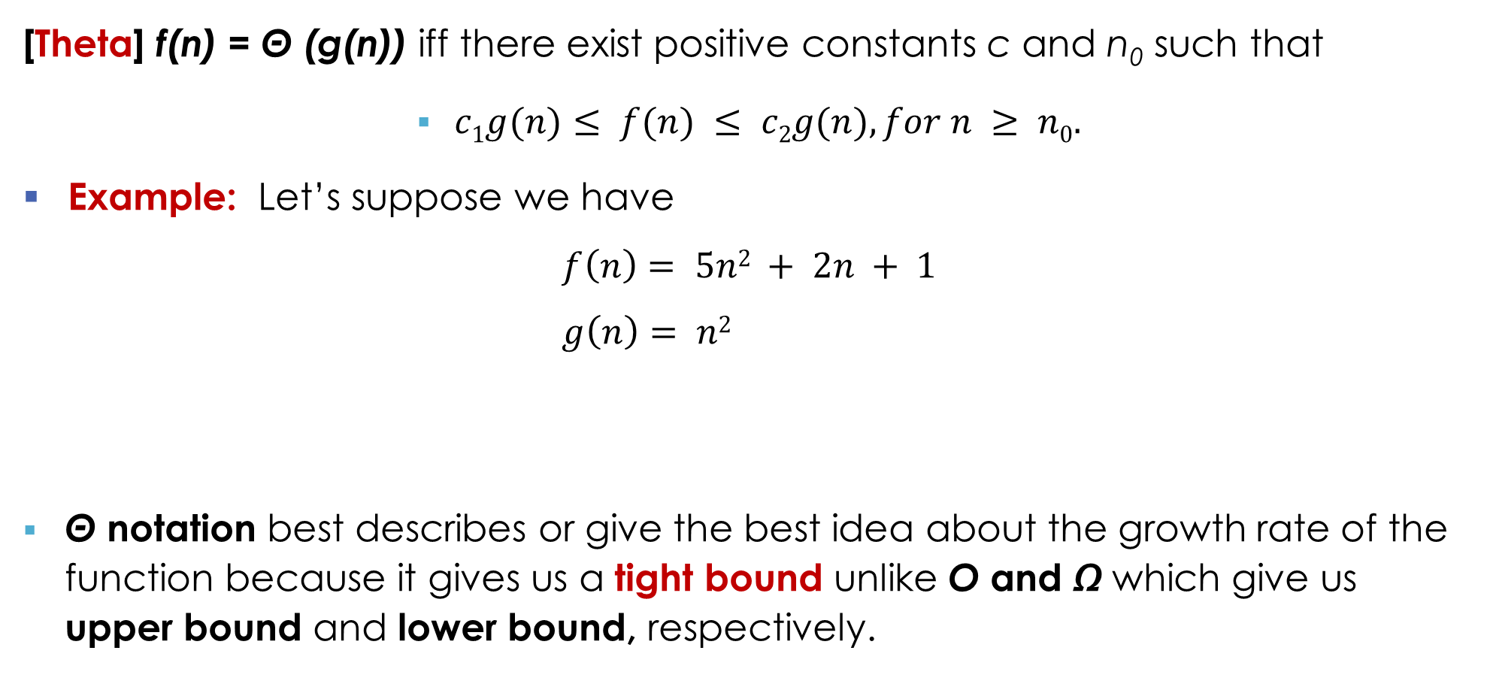
Asymptotic Analysis 점근적 분석과 표기법
[Theta] f(n) = Θ (g(n)) iff there exist positive constants c and n₀ such that
$c1g(n)≤ f(n) ≤ c2g(n), for n ≥ n0.$
Example: Let’s suppose we have $f\left(n\right)= 5n2 + 2n + 1$ $g\left(n\right)= n2$
Θ notation best describes or give the best idea about the growth rate of the function because it gives us a tight bound unlike O and Ω which give us upper bound and lower bound, respectively.
c₂ g(n)
f(n)
c₁ g(n)
time
n₀ = 1
input n

Slide 25
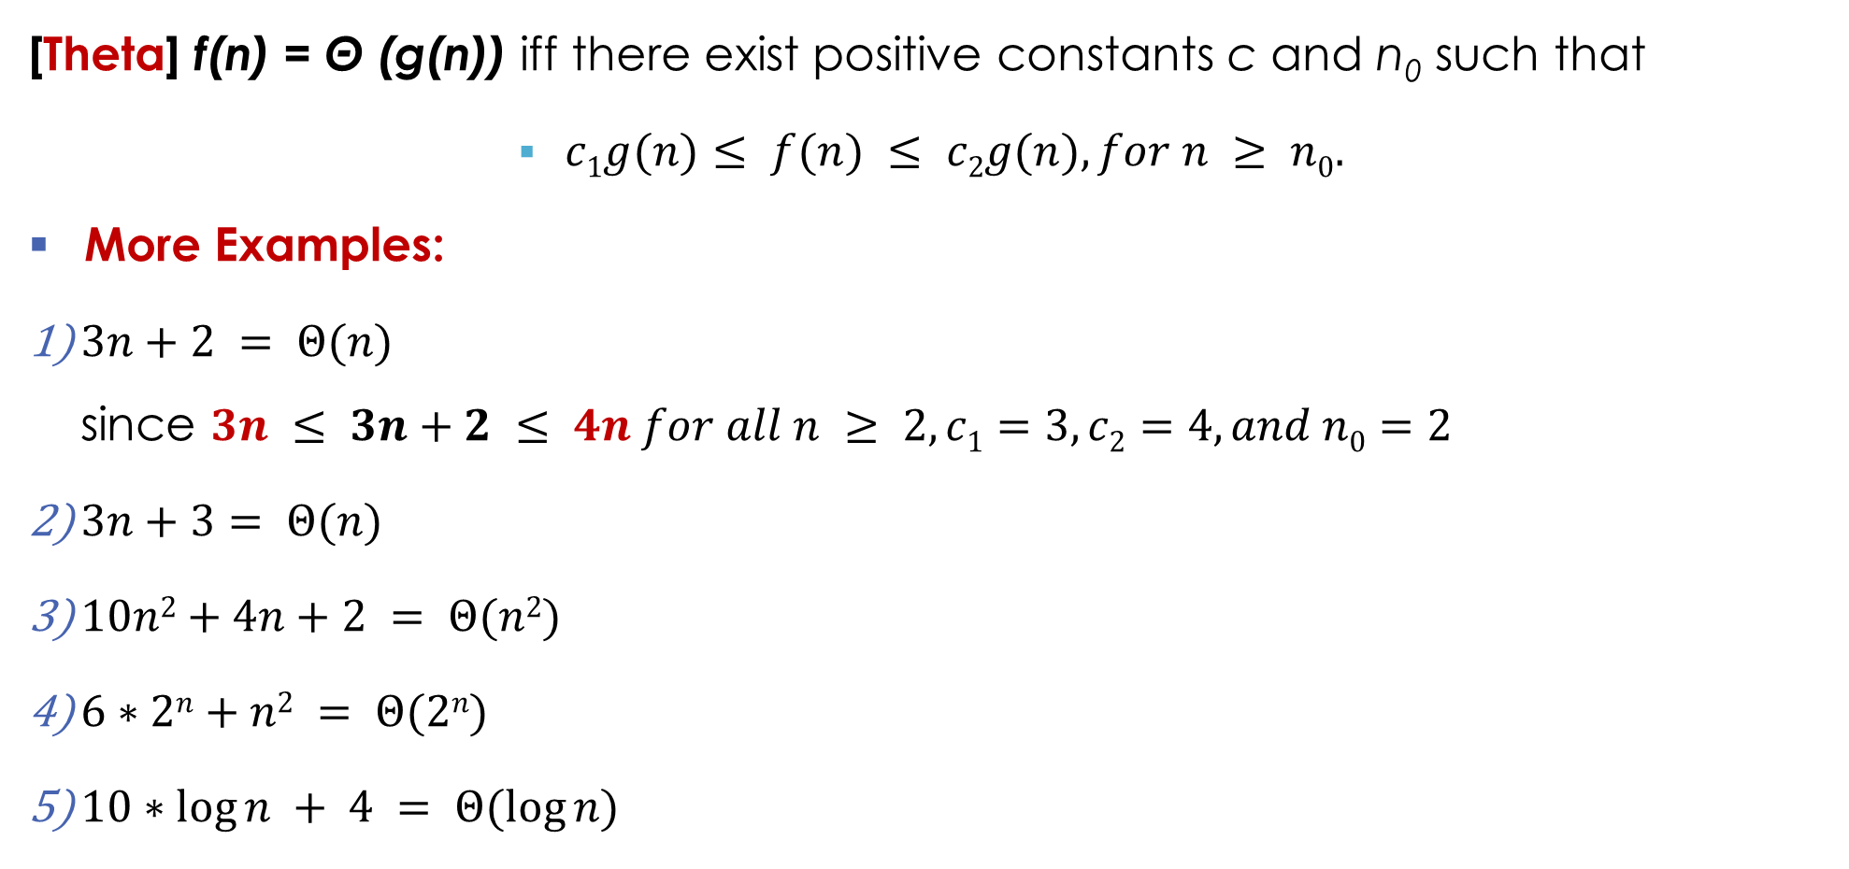
Asymptotic Analysis 점근적 분석과 표기법
[Theta] f(n) = Θ (g(n)) iff there exist positive constants c and n₀ such that
$c1g(n)≤ f(n) ≤ c2g(n), for n ≥ n0.$
More Examples:
$3n+2 = Θ(n)$ since $3n ≤ 3n+2 ≤ 4n for all n ≥ 2,c1=3, c2=4,and n0=2$
$3n+3= Θ(n)$
$10n2+4n+2 = Θ(n2)$
$6∗2n+n2 = Θ(2n)$
$10∗log⁡n + 4 = Θ(log⁡n)$

Slide 26


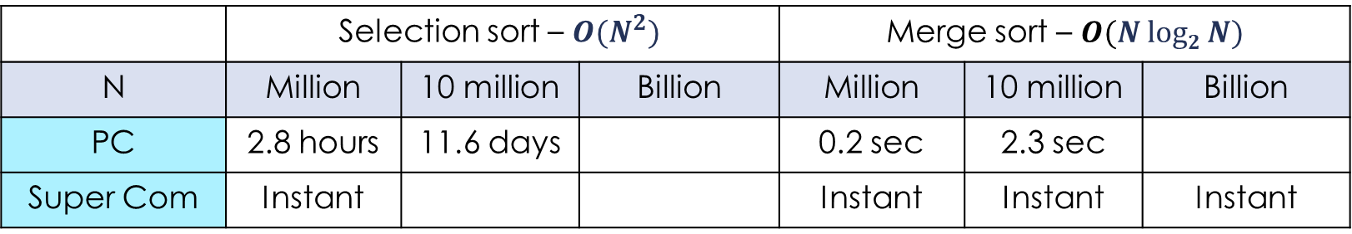
Asymptotic Analysis - Quiz
Example: Running time estimates - empirical analysis
Personal computer executes ${10}^{8}$ compares/second
Supercomputer executes ${10}^{12}$compares/second
 | Selection sort – ${O(N}^{2})$ |  |  | Merge sort – $O(N log2 N)$
N | Million | 10 million | Billion | Million | 10 million | Billion
PC | 2.8 hours | 11.6 days |  | 0.2 sec | 2.3 sec
Super Com | Instant |  |  | Instant | Instant | Instant
$$\log_{10}2≅0.3$$
$$\log_{2}10≅3.3$$
$$86,400sec/day$$
instant < 0.1 sec
Use a reasonable or understandable time units.
Do not say, for example, "3660 days" nor "1220 seconds",
but 10.0 years or 20.3 min, respectively.
※ Bottom line: Good algorithms are better than supercomputers.

Slide 27
Data Structures Chapter 1
Recursion
Performance Analysis
Asymptotic Analysis
Revisit – Step Count
Asymptotic Analysis
Asymptotic Notations

Slide 28



Asymptotic Analysis – Quiz
Example: Running time estimates - empirical analysis
Personal computer executes ${10}^{9}$ compares/second
Supercomputer executes ${10}^{13}$compares/second
 | Selection sort – ${O(N}^{2})$ |  |  | Merge sort – $O(N log2 N)$
N | Million | 10 million | Billion | Million | 10 million | Billion
PC | 16.7 min |  |  | instant | 0.2 sec
Super Com | 0.1 sec |  |  | Instant | Instant | Instant
$$\log_{10}2≅0.3$$
$$86,400sec/day$$
instant < 0.1 sec
Use a reasonable or understandable time units.
Do not say, for example, "3660 days" nor "1220 seconds",
but 10.0 years or 20.3 min, respectively.
※ Bottom line: Good algorithms are better than supercomputers.

Slide 29

Asymptotic Analysis
Example: Running time estimates - empirical analysis
Personal computer executes ${10}^{9}$ compares/second
Supercomputer executes ${10}^{13}$compares/second
 | Selection sort – ${O(N}^{2})$ |  |  | Merge sort – $O(N log2 N)$
N | Million | 10 million | Billion | Million | 10 million | Billion
PC | 16.7 min | 27.8 hours | 31.7 years | instant | 0.2 sec | 29.9 sec
Super Com | 0.1 sec | 10 sec | 27.8 hours | Instant | Instant | Instant
$$\log_{10}2≅0.3$$
$$86,400sec/day$$
instant < 0.1 sec
Use a reasonable or understandable time units.
Do not say, for example, "3660 days" nor "1220 seconds",
but 10.0 years or 20.3 min, respectively.
※ Bottom line: Good algorithms are better than supercomputers.

Slide 30

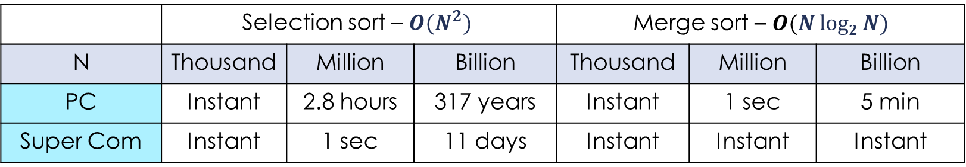
Asymptotic Analysis
Example: Running time estimates - empirical analysis
Personal computer executes ${10}^{8}$ compares/second
Supercomputer executes ${10}^{12}$compares/second
 | Selection sort – ${O(N}^{2})$ |  |  | Merge sort – $O(N log2 N)$
N | Thousand | Million | Billion | Thousand | Million | Billion
PC | Instant | 2.8 hours | 317 years | Instant | 1 sec | 5 min
Super Com | Instant | 1 sec | 11 days | Instant | Instant | Instant
$$\log_{10}2≅0.3$$
$$86,400sec/day$$
instant < 0.1 seㅊ
Use a reasonable or understandable time units.
Do not say, for example, "3660 days" nor "1220 seconds",
but 10 years and 10 days, or 20 minutes 20 seconds.
※ Bottom line: Good algorithms are better than supercomputers.

Slide 31
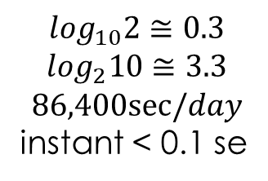
Asymptotic Analysis
Example: Running time estimates - empirical analysis
Personal computer executes ${10}^{8}$ compares/second
Supercomputer executes ${10}^{12}$compares/second
 | Selection sort – ${O(N}^{2})$ |  |  | Merge sort – $O(N log2 N)$
N | Thousand | Million | Billion | Thousand | Million | Billion
PC | Instant | 2.8 hours | 317 years | Instant | 1 sec | 5 min
Super Com | Instant | 1 sec | 11 days | Instant | Instant | Instant
$$\log_{10}2≅0.3$$
$$\log_{2}10≅3.3$$
$$86,400sec/day$$
instant < 0.1 se
Use a reasonable or understandable time units.
Do not say, for example, "3660 days" nor "1220 seconds",
but 10 years and 10 days, or 20 minutes 20 seconds.
※ Bottom line: Good algorithms are better than supercomputers.

